Slide 1
Business Monitor
Q1 2016
Summary Results

Slide 2
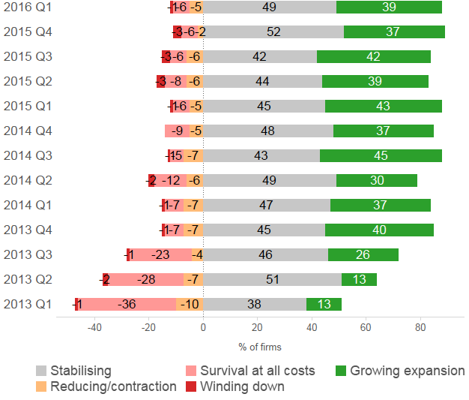
“Business position picture remains positive although the momentum behind growth continues to slow...”
Business position
Which of the following best describes the current position of your business?

Slide 3
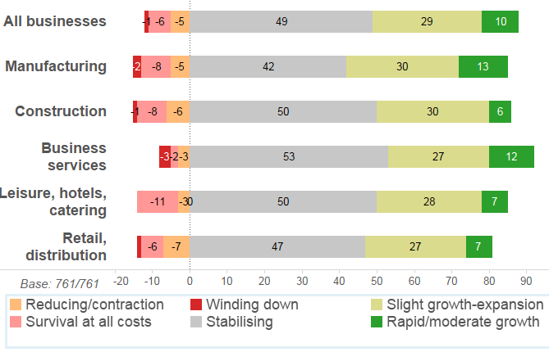
“...all sectors growing with Construction performing strongly...”
Business position
Which of the following best describes the current position of your business?

Slide 4
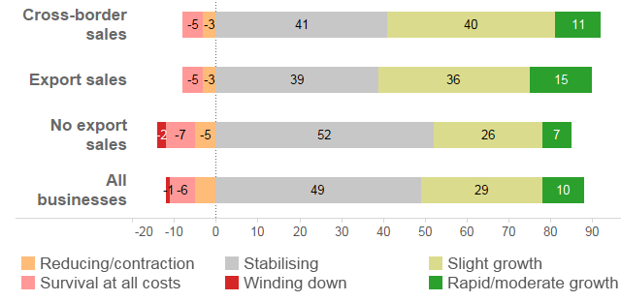
“...and exporters and cross-border traders continue to outperform domestic businesses...”
Business position
Which of the following best describes the current position of your business?

Slide 5
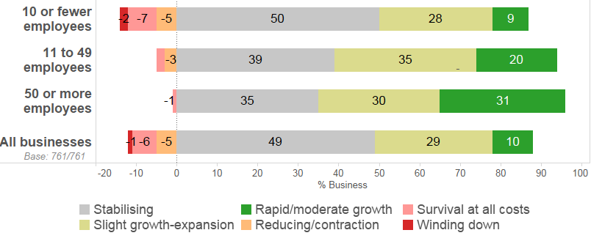
“...an imbalance exists in the size of firms growing with small firms continuing to fall behind...”
Which of the following best describes the current position of your business?
Business position

Slide 6
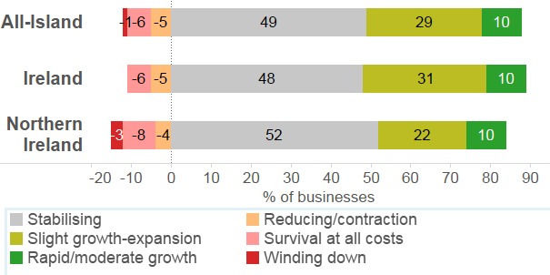
“...and clear growth gap between businesses in the North and the South in the current quarter...”
Which of the following best describes the current position of your business?
Business position

Slide 7
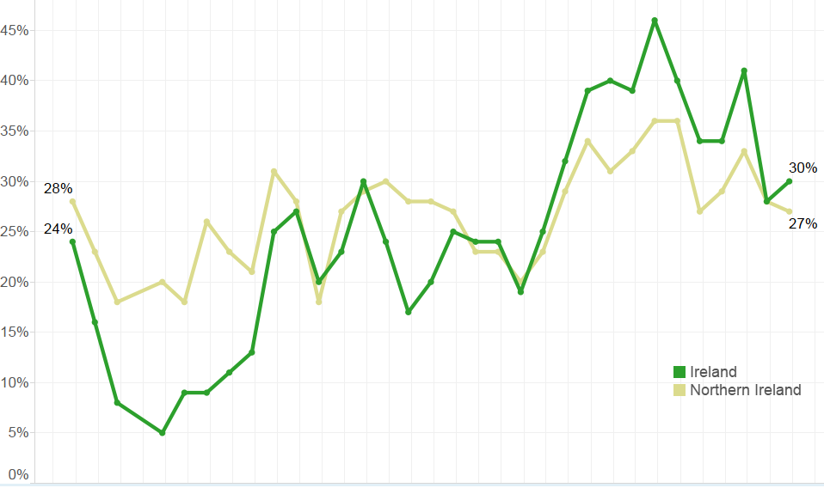
“Improving sales performance by businesses in Ireland this quarter...”
Businesses increasing sales in past quarter

Slide 8
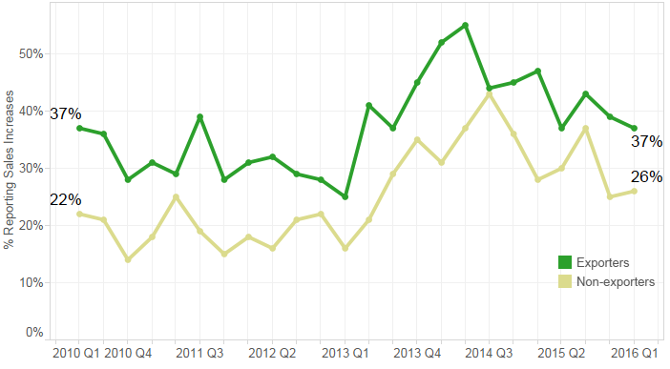
“Despite a dip in the number of businesses reporting increasing sales, exporters continue to do better than the firms reliant on the domestic market.”
Businesses increasing sales: exporters vs non-exporters

Slide 9
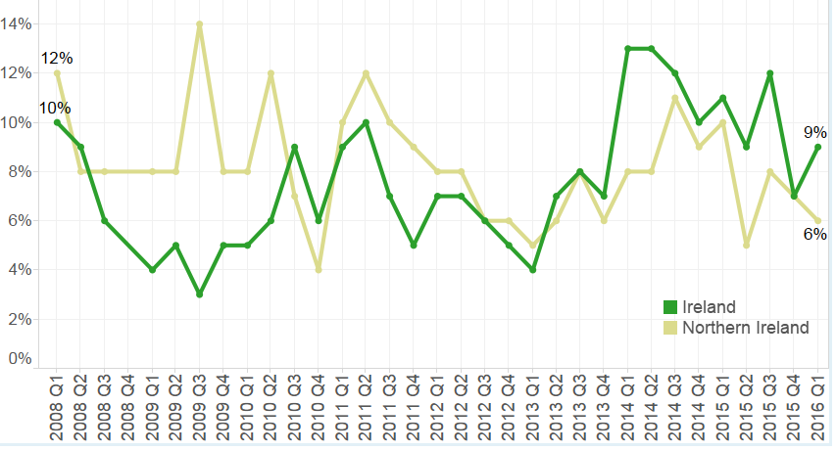
“Some signs of a growing number of Irish firms increasing their employment again...”
Businesses increasing employment in past quarter

Slide 10
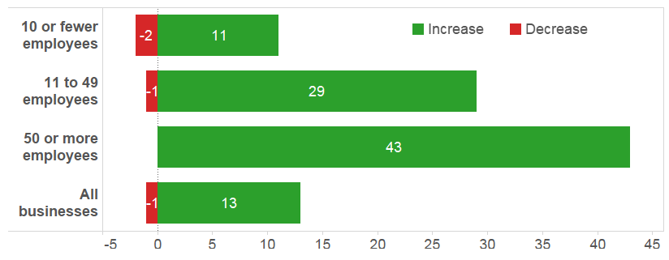
“...and many firms, especially those with more than 10 employees, hoping to do so in the next year as well...”
Businesses expecting to increase employment in the next 12 months

Slide 11
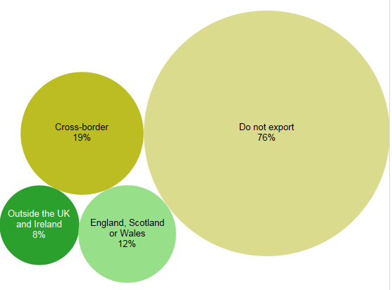
“Three quarters of firms not currently exporting and missing opportunities for growth...”
Does your business sell into these markets?

Slide 12
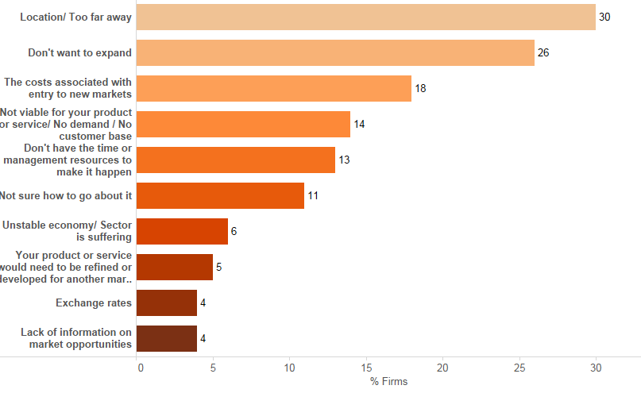
“...and giving a variety of reasons for their apprehension about taking the first steps into exporting...”
Reasons given for not engaging in cross-border trade

Slide 13
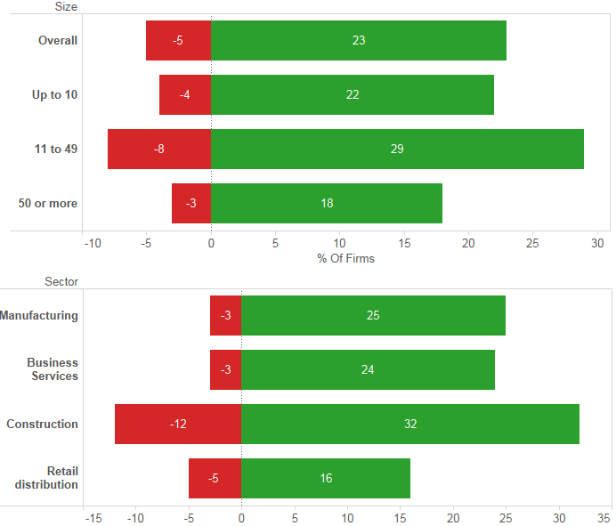
“...but those engaged are increasing their sales...”
Have your sales in the cross-border market decreased in the past year?

Slide 14
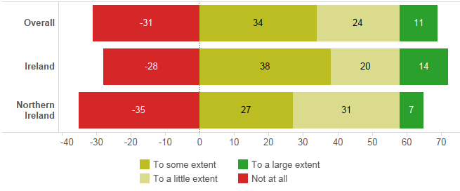
“...and 69% are using the cross-border experience to move on into other new markets.”
Extent of influence of cross-border trade on
developing new export markets

Slide 15
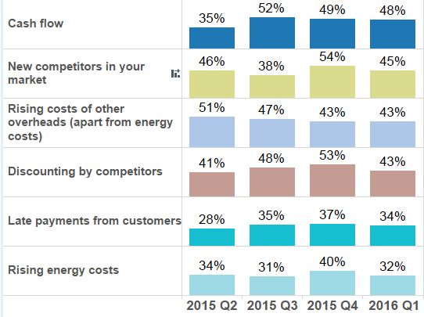
“Most issues continuing to decline with cash flow and competition the key ones.”
Key challenges for businesses
Most of the challenges faced by businesses continue to decline in importance with the exception of those due to pressures from the market
Cashflow remains a leading issue facing firms
New competitors and discounting now a concern for a significant number of firms, putting a downward pressure on prices
Euro/sterling exchange rates has declined as an issue with the exception of exporters and larger businesses.
Access to Finance may be re-appearing as an issue, now affecting a quarter of all firms

